Slide 1

NORTH AMERICA AND THE CARIBBEAN REGION
“Inspire, Innovate, Empower, Transform: Together We Shape a Sustainable Future”.
Karin Gorgerat Regional Coordinator Annual Report Nov 2025

Slide 2
NAC Regional Committee
Regional Coordinator – Karin Gorgerat
Finance Officer – Catherine Magedeleine (St Martin)
Secretary – Rhoda St John (Dominica)
Constitutional Advisor – Bessie Hironimus (USA) Young BPW Rep – vacant
Training Coordinator – Sujata Tiwari (St Kitts)
Advocacy Coordinator – Colleen Babiuk-Ilkiw (Canada)
Communication/Newsletter Coordinator – Vanessa Bruno (Dominica)
President Canada Shan McEwing President NFBPWC (USA) – Barbara Bozeman
IFBPW VP Membership Francesca Burrack
IFBPW PIP and CAC Chair – Liz Benham
IFBPW Standing Committee Chair Arts and Culture Sher Singh

Slide 3

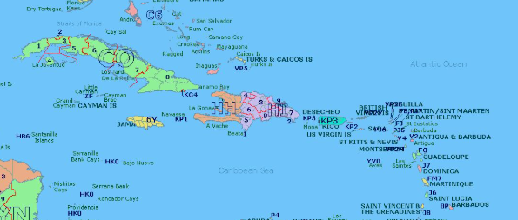
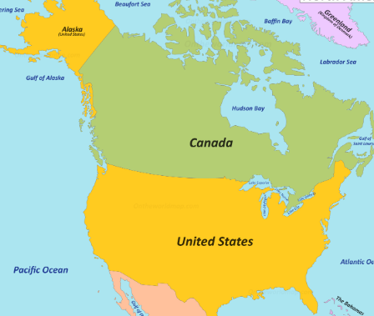
North America and the Caribbean
Federations: Canada and NFBPWC (USA)
Affiliates:
Freeport, Grand Bahamas Barbados
Bermuda Dominica
Grand Cayman Haiti
St Andrews, Jamaica Concordia St Martin
St Kitts & Nevis (3 clubs St Kitts, Liamuiga and Nevis)

Slide 4
Strategic Plan Goals
1. Membership – Growth and Retention – Inspire & Innovate
2. Advocacy – Educate and Empower
3. Leadership Development – Sustain and Succession Planning - Transform

Slide 5


Membership Growth – Inspire & Innovate
Goals for membership include:
3 New Affiliate Clubs Results to Nov 2025 1 New Club
Increase in membership of current Affiliates/Federations
Increase engagement of current membership
Within their Club/Federation Information sharing with NAC Quarterly Newsletter
Within NAC Results 5 countries represented on NAC Committee
Within IFBPW Results 28 NAC members on Standing Committees/Task Forces as well as UN Organizations such as OAS (Organization of American States)

Slide 6

Advocacy – Educate and Empower
Regional Advocacy Champion in NAC to work with Federations/Affiliates Colleen Babiuk-Ilkiw
Webinars to train how to Advocate Sept 15 – Advocacy on the Line – Crafting Position Papers to Spark Change
UN Country Representatives – bring awareness of UN connection to their countries and increase engagement Natasha Yeeloy-Labad Webinar for Club Reps Oct 22, 2025

Slide 7

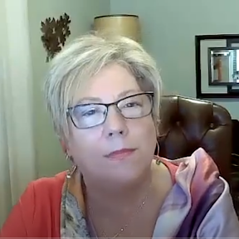
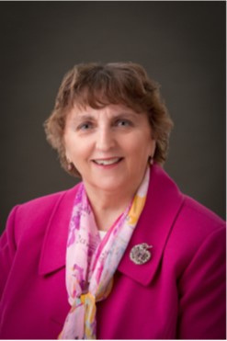
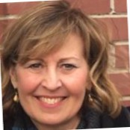
NAC presents
Advocacy on the Line:
Crafting Position Papers to Spark Change!
Guest Presenter: Sheila Crook, BPW Canada
Co-founder Canadian Coalition to Empower Women (CCEW);
IDEAS4GE Project Liaison - Inclusion, Diversity, Equity, Access in the Workplace
Karin Gorgerat
Colleen Babiuk-Ilkiw
NAC Regional Coordinator
Committee Chair
September 15, 2025 at 7:00 PM Eastern Time (US and Canada)
Register in advance:
https://us06web.zoom.us/meeting/register/mlnHICSKRQOeaG5ZpldMWA
After registering, you will receive a confirmation email containing information about joining the meeting
Notes:
1 -3 Minutes? - Colleen welcome/Land acknowledgment –
Special Guests- Regional Coordinator….
Do you plan to do a Land Acknowledgment? Can insert slide if you wish or you can do it with you opening remarks with this slide?

Slide 8

Leadership Development-Sustain and Succession Planning - Transform
Regional Training Coordinator to work with Federations/Affiliates – Sujata Tiwari
Webinars with membership to train on Executive & Leadership positions (2/year) Sept 29 – Empowering BPW Leaders
Mentorship 2nd webinar to include January 2026 date TBD
Education – to show value of BPW International membership and prepare to take on Leadership roles in their BPW Affiliates/Federations and/or BPW International Feb 2025 Showcasing BPW Webinar

Slide 9
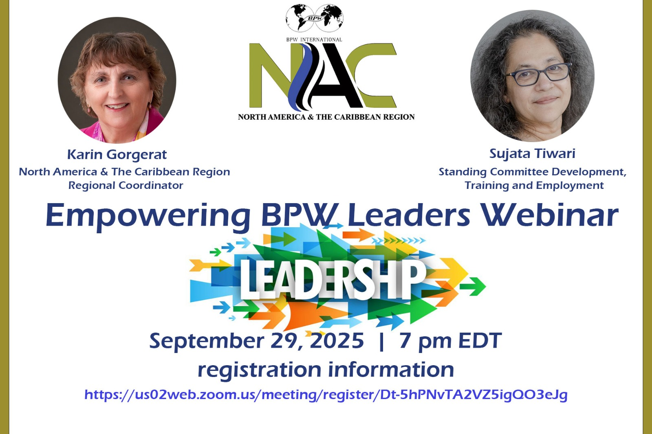

Slide 10

Measurement of Success
Increase in Membership – number of members/Affiliates in NAC – to be determined after Dec 31 2025
Increase number of members in the NAC Region in NAC Committees or BPWI Standing Committees 28 members on Standing Committees
Evidence of advocacy work in Federations/Affiliates – to be determined by June 2026
# of Webinars held to educate members
4 Webinars held to date

Slide 11
Some Projects within NAC
Hosting Events to increase BPW’s visibility including IFBPW’s 95th anniversary
Members in Motion series – empowerment of women
Educating women on Safety and Security measures to stay safe
Hosting a Health Expo to offer free health checks for women
Managing a Crisis Centre Hotline offering counselling in Domestic and Intimate Partner Violence, Rape, Incest and Suicide
Managing a Women’s Shelter for abused Women and Children
Collaborating with like-minded organizations to create a bigger impact (ie. Organization of American States)
Sending Briefs to Government which include Resolutions passed on Women’s Issues
Education on Period Poverty
NAC Webinars - September 15 – Advocacy on the Line – Crafting Position Papers to Spark Change, September 29 – Empowering BPW Leaders February 2025 - Showcasing BPW
Monthly Webinars on various topics by NFBPWC and Canada – including Leadership, Violence against Women, JEDI (Justice Equality Diversity Inclusion).

Slide 12
Events within or Representing NAC
80th Anniversary Celebration BPW London, Ontario Canada
75th Anniversary Celebration BPW Bowmanville, Ontario Canada
50th Anniversary Celebration BPW St Kitts
1st Anniversary Celebration BPW Freeport, Grand Bahamas
Monthly submissions in BPW Canada and NFBPWC Newsletters
Attendance at CSW 69 as Delegate of BPW Canada
Attended BPW Europe Regional Conference in Malta with other members of NAC
BPW Haiti continues to struggle due to the state of the country – 6 million people in need of humanitarian assistance, gang violence, extreme hunger, lack of housing
Application form created to choose Delegates for CSW 70 from NAC Affiliates (not Canada as they have their own Status through ECOSOC)
NAC Conference Planning – location and dates firmed up
Meetings about potential new affiliates
Member of Participatory Diagnosis team and RC Liaison

Slide 13



AUGUST 23 YOUTH SYMPOSIUM
AUGUST 24 & 25 LEADER’S SUMMIT,
PRESIDENT’S MEETING, CONFERENCE

