Slide 1

NORTH AMERICA AND THE CARIBBEAN REGION
“Inspire, Innovate, Empower, Transform: Together We Shape a Sustainable Future”.
Karin Gorgerat
Regional Coordinator

Slide 2

IFBPW Executive
        President Diana Barragan
        1st Vice President UN Neelima Basnet
        2nd Vice President Membership Francesa Burrack
        Executive Finance Officer – Gudrun Jakobsdottir
        Executive Secretary – Caroline Savage
        Young BPW Representative – Izadora Letchacoski
        Immediate Past President – Catherine Bosshart
        Regional Coordinators (5 Regions)
        Africa Latin America
        Asia-Pacific North America and the Europe Caribbean

Slide 3
IFBPW Standing committees
Agriculture Environment
Arts & Culture Health
Development, Training & Employment
Business, Trade & Technology
Projects United Nations
Legislation Membership
Public Relations Young BPW

Slide 4

North America and the Caribbean committee
Regional Coordinator – Karin Gorgerat
Finance Officer – Catherine Magedeleine (St Martin)
Secretary – Rhoda St John(Dominica)
Constitutional Advisor – Bessie Hironimus (USA) Young BPW Rep – Bryn Norrie (USA)
Training Coordinator – Sujata Tiwari (St Kitts)
Advocacy Coordinator – Colleen Babiuk-Ilkiw (Canada)
Communication/Newsletter Coordinator – Vanessa Bruno(Dominica)
President Canada Shan McEwing President NFBPWC (USA) – Barbara Bozeman
IFBPW VP Membership Francesca Burrack
IFBPW PIP and CAC Chair – Liz Benham
IFBPW Standing Committee Chair Arts and Culture Sher Singh

Slide 5

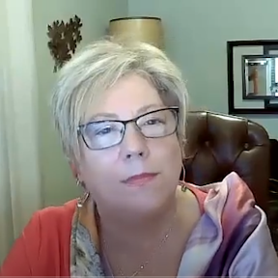
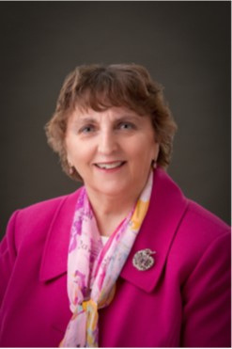
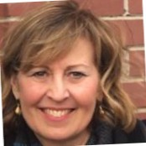
NAC presents
Advocacy on the Line:
Crafting Position Papers to Spark Change!
Guest Presenter: Sheila Crook, BPW Canada
Co-founder Canadian Coalition to Empower Women (CCEW);
IDEAS4GE Project Liaison - Inclusion, Diversity, Equity, Access in the Workplace
Karin Gorgerat
Colleen Babiuk-Ilkiw
NAC Regional Coordinator
Committee Chair
September 15, 2025 at 7:00 PM Eastern Time (US and Canada)
Register in advance:
https://us06web.zoom.us/meeting/register/mlnHICSKRQOeaG5ZpldMWA
After registering, you will receive a confirmation email containing information about joining the meeting
Notes:
1 -3 Minutes? - Colleen welcome/Land acknowledgment –
Special Guests- Regional Coordinator….
Do you plan to do a Land Acknowledgment? Can insert slide if you wish or you can do it with you opening remarks with this slide?

Slide 6
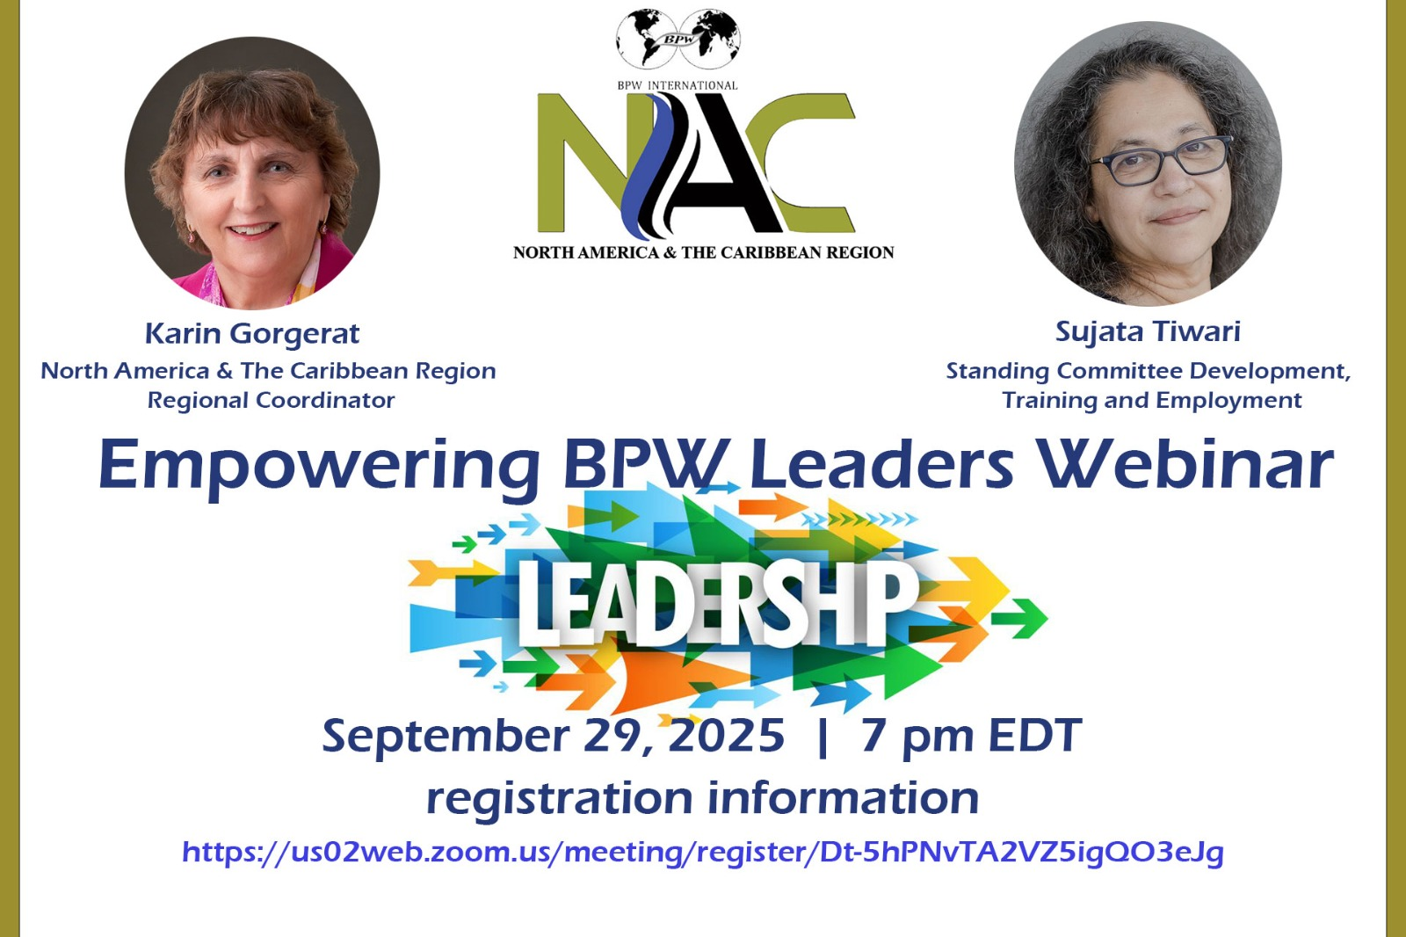

Slide 7

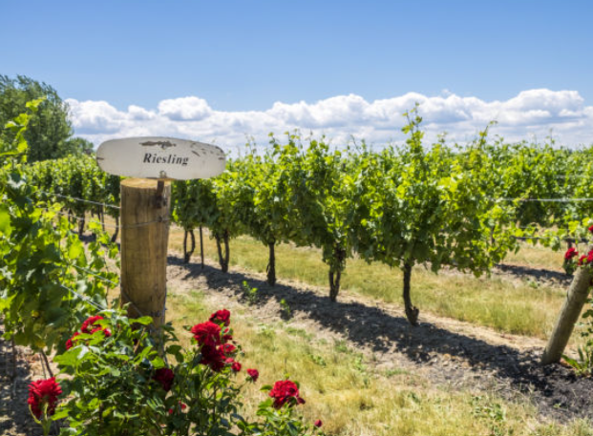
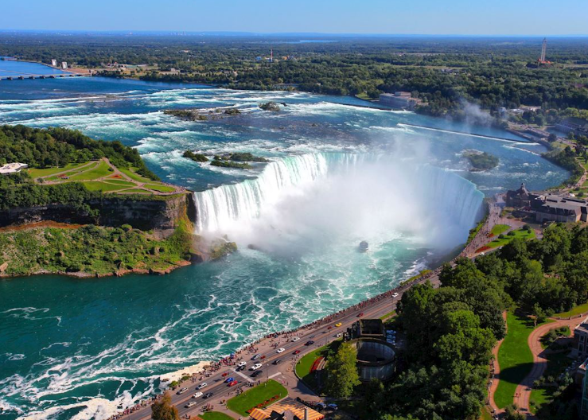

NORTH AMERICA AND CARIBBEAN REGIONAL CONFERENCE
NIAGARA FALLS, ONTARIO, CANADA
AUGUST 23 YOUTH SYMPOSIUM
AUGUST 24 & 25 LEADER’S SUMMIT, CONFERENCE, PRESIDENT’S MEETING

Slide 8
UPCOMING IFBPW EVENTS
September 15, 2025 – NAC Webinar – Advocacy on the Line – Crafting Position Papers to Spark Change
September 29, 2025 – NAC Webinar – Empowering BPW Leaders
April 9 – 12, 2026 – Africa Regional Conference Marrakesh, Morocco
August 23 – 25, 2026 – North America & Caribbean Regional Conference Niagara Falls, Ontario, Canada
2026 – Latin America Regional Conference location & date TBA
2027 – IFBPW Congress location and date TBA
Annually – Leader’s Summit (March 6 & 7, 2026) and Commission on Status of Women (CSW) (March 9 – 20, 2026) New York City USA
Notes:
Congresses, Conventions and Conferences are opportunities to learn from Guest speakers and workshops as well as meet members in person from around the world, across the country or province. I can’t express enough the value of this – by being a member you have access to other members that will become friends and mentors.

