Slide 2

Juror Comments
Seven (7) pieces of art were submitted to the competition. Entrants were from Manitoba, Ontario and Quebec and ranged in age from 16 to 34. The media they used included ink, micron paint, acrylic paint, glass beads, blown glass, and water colour. All entries provided inspiring statements, and it was easy to see the influence of the feminine in the art. A difficult choice has been made. We prioritized those with clear messages of "Expanding Possibilities Together".

Slide 3
Recipients of $1,000 Cash Scholarships Each

Slide 4
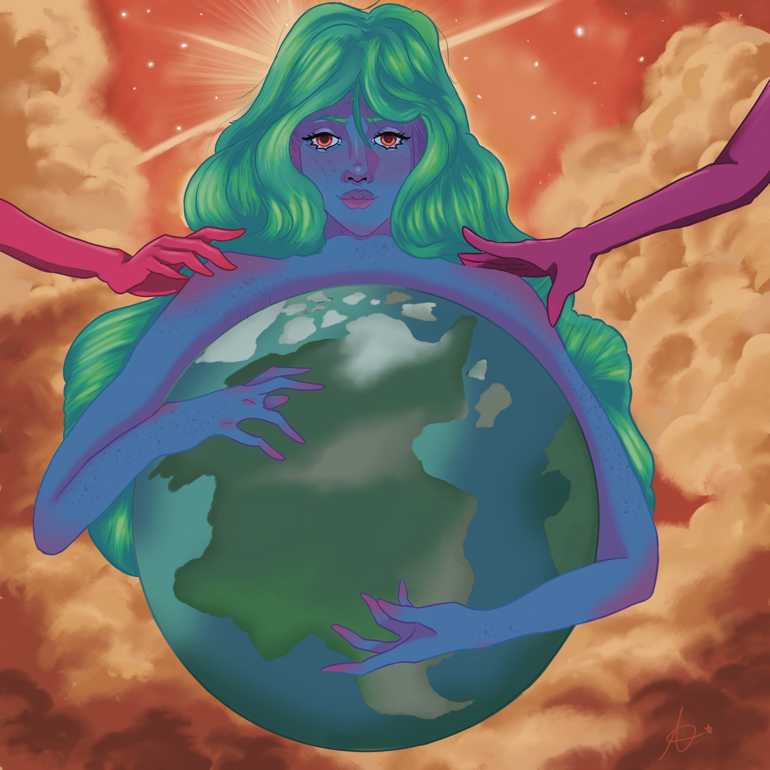
Celestial Bodies by Autumn Davies,
Belleville, Ontario
Autumn – ‘During the process of coming up
with my composition I kept thinking "what
does expanding possibilities together look
like to me" so I chopped it up into pieces and
looked at it in separate parts rather than a
whole concept. Expanding, to me, means
helping others to grow and succeed and
almost even help carry the weight of their
problems. As for the possibilities side of
things, my mind kept going to 'out of this
world types of things' like stars and the
galaxy….This piece was by far the most
meaningful artwork I believe I have ever
created.’
Sponsorship: Estate of Laura Noble

Slide 5
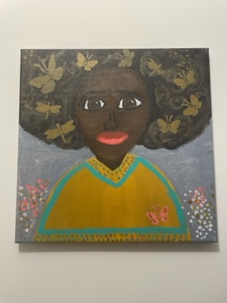
Soul Girl by Tassani Fast,
Niverville, Manitoba
Tassani – ‘Wanted to make a self
portrait to represent who I am: a girl
with many goal and dreams
represented by the butterflys in
the hair.’
Sponsorship: Estate of Laura Noble

Slide 6
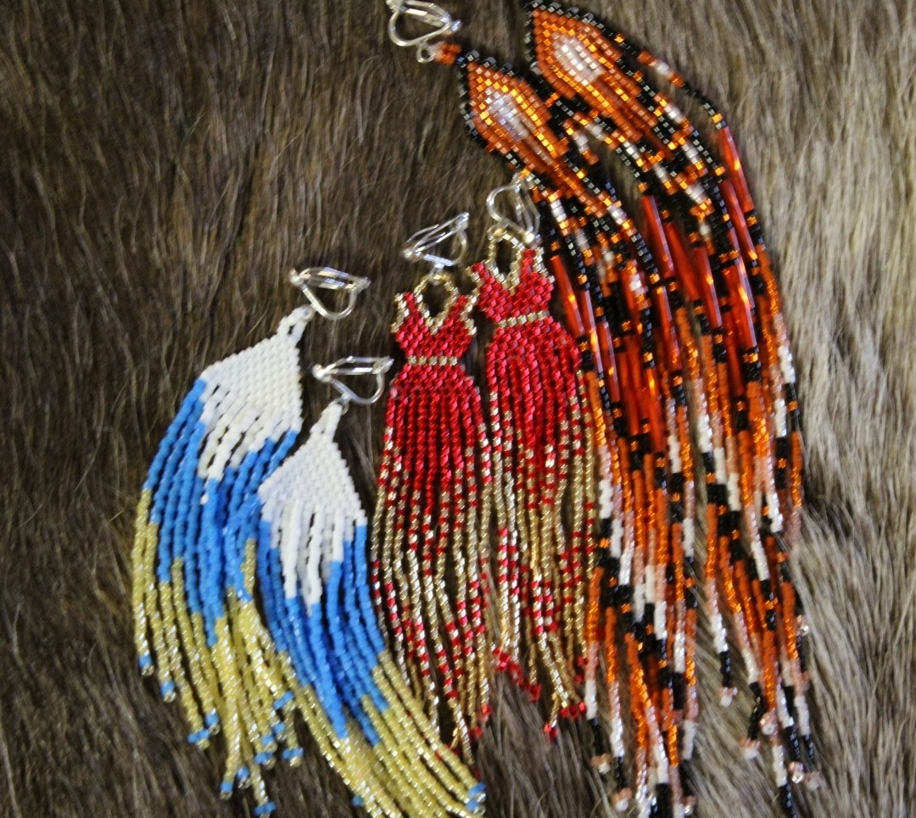
Beaded Possibilities by Dakota Mathieu,
Sault Ste. Marie, Ontario
Dakota – ‘Learning to bead in Gwichin land (Yukon and NWT), you learn quickly that these beads represent so much; especially that they often create new possibilities in these remote communities as well as more financial stability. They also represent a sense of community I’ve never really experienced elsewhere.’
Sponsorship: Planning by Design,
London, Ontario

Slide 7
Remaining Submissions

Slide 8
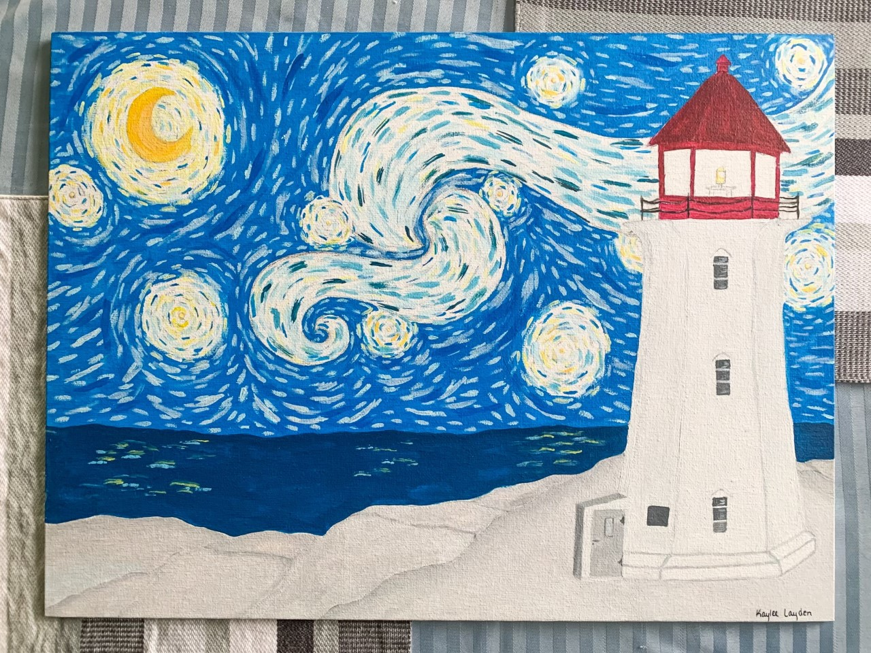
Soul Expression by Kaylee Layden,
Niagara Falls, Ontario
Kaylee – ‘*SOUL EXPRESSION”
acknowledges the real ME.
Girls and women need to
build their confidence and
recognize that they can grow
spiritually, physically and
emotionally by daring to work
hard for accomplishments
and surmounting challenges
and fight for their rights so
that they can be whatever
they want, do whatever they
want, if they have the desire
and passion to reach forward
and to take a chance to reach
for the stars and beyond.’

Slide 9
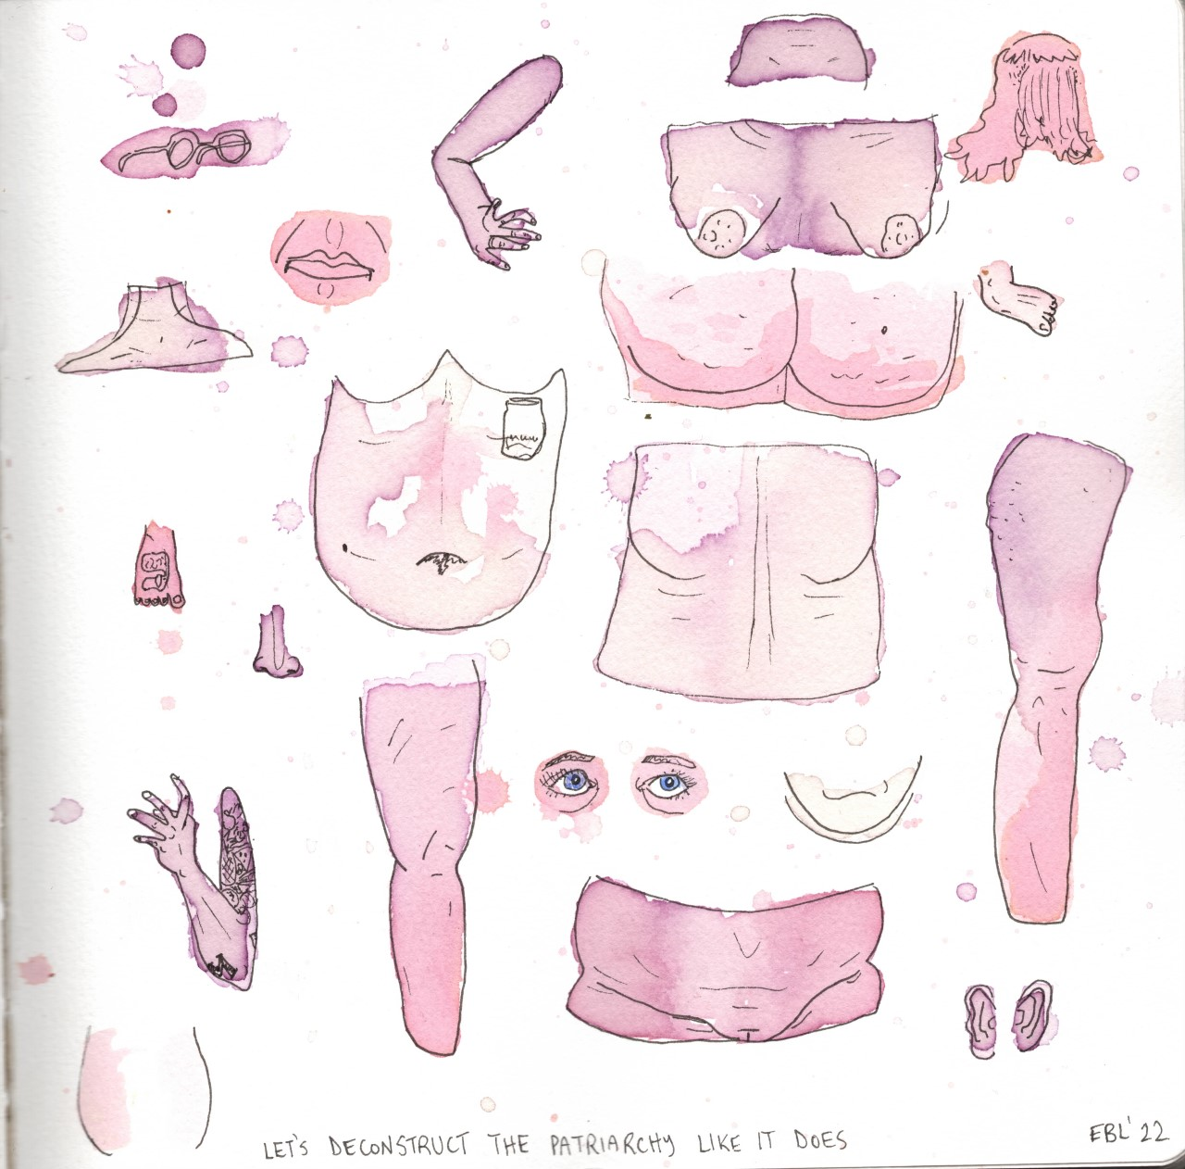
Let’s Deconstruct the Patriarch Like It Does by Emily Bos Lemen,
Barrie, Ontario
Emily – ‘My inspiration was a conversation
with my pelvic floor physiotherapist;
how those who identify as women
are analyzed, abused, judged and
considered in pieces rather than a
whole and how it affects us culturally
and socially.’

Slide 10
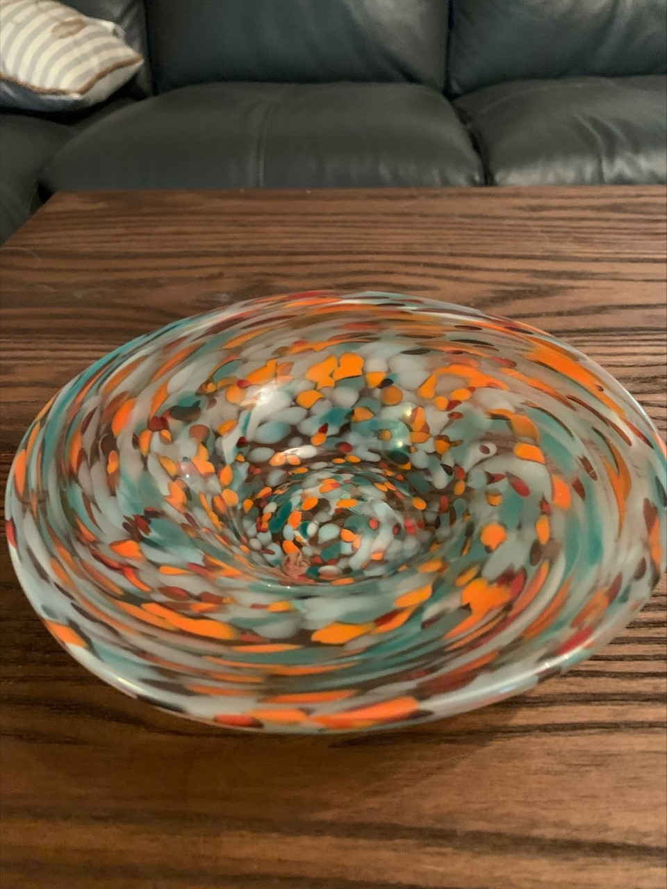
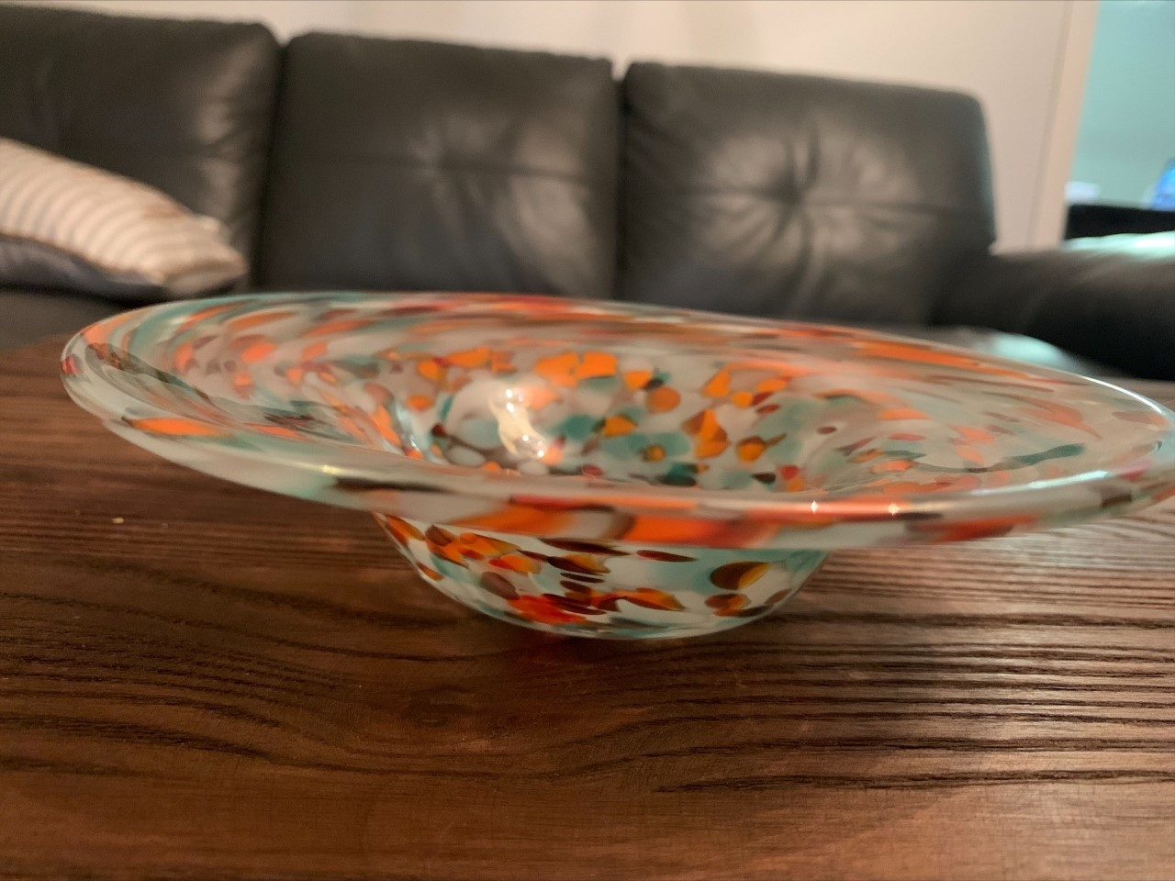
Hawaiian Punch by Natalie Moore,
Gatineau, Quebec

Slide 11
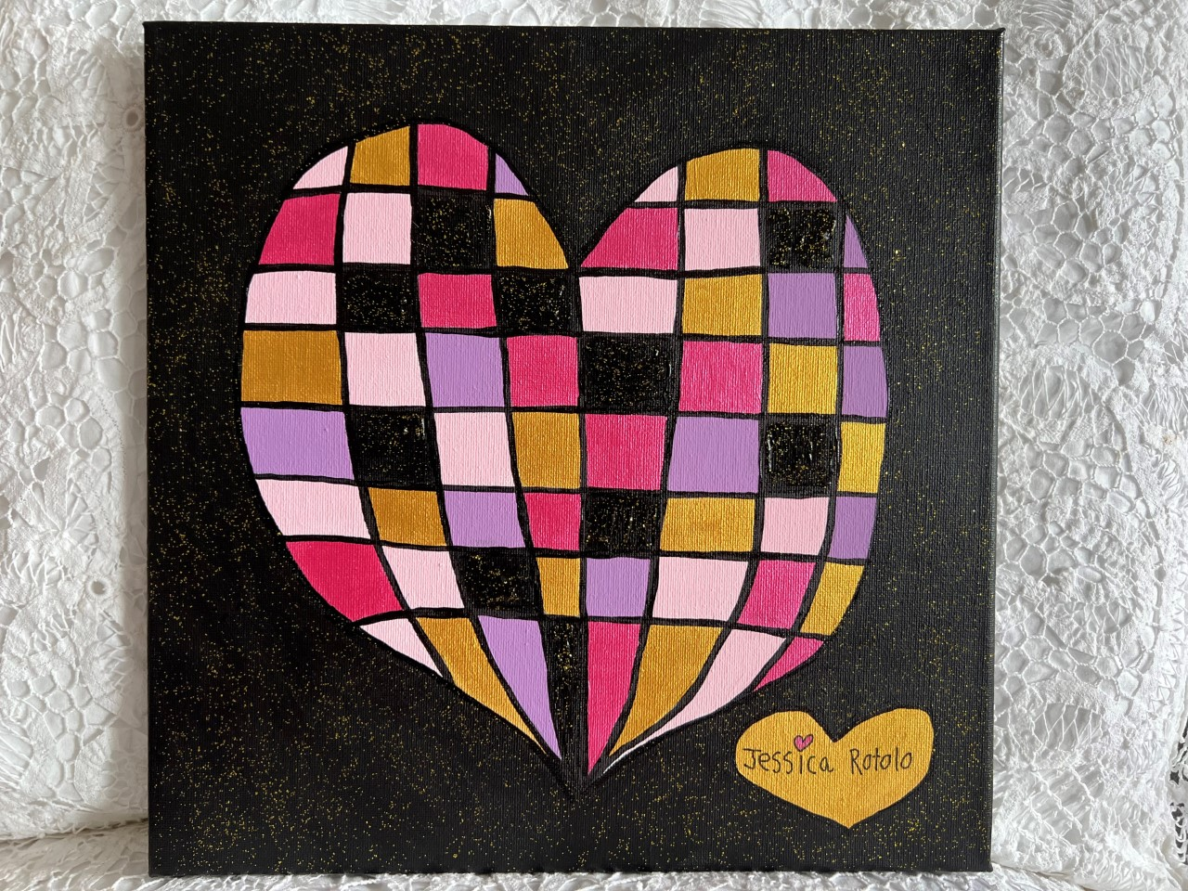
Love BPW to Bits by Jessica Rotolo,
Toronto, Ontario
Jessica – ‘I was born with Down Syndrome. I have been painting my hearts since I was 4 years old. They help me express my love to family, friends and the world.’

Slide 12
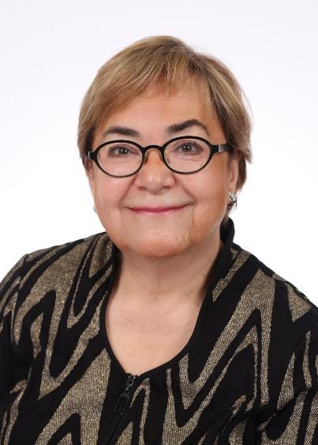
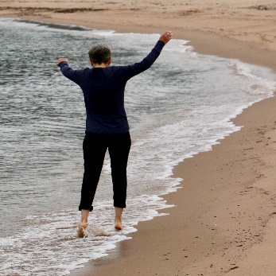
Thank you to Jurors
Maide Yazar and Deborah Pryce
Deborah Pryce
Multi Media Artist,
Creating and Living Large
in Lunenburg, Nova Scotia
www.deborahpryce.com
Maide Yazar,
North Toronto BPW Member
Lead, Art Competition Team

